Slide 1

Conceptual, Logical and Physical Design
Presented By:
Elizer Ponio Jr. Department of Computer Science
College of Computing and Information Technologies

Slide 2
Database Design
Databases are the backbone of modern information systems, serving as repositories for organized and structured data.
When designing a database, it’s crucial to follow a structured approach that involves three distinct levels: conceptual, logical, and physical database design

Slide 3
Conceptual Design
Conceptual database design is the highest level of abstraction in the database design process.
At this stage, designers focus on understanding the problem domain and defining the overall structure of the database without getting into technical implementation details.
The primary goal is to create a clear and comprehensive representation of the data and its relationships.

Slide 4
Conceptual Design
Entities:
Student
Course
Instructor, Department
Enrolls
Student
Course
Enrolls
Instructor
Course
Relationships:
Student enrolls in Course
Instructor teaches Course
Department manages Course
Manages
Deparment
Course

Slide 5
Logical Design
Logical database design bridges the gap between the conceptual and physical levels.
Here, designers translate the conceptual model into a more detailed representation, focusing on data structures, relationships, and constraints.
The logical design is independent of any specific database management system (DBMS) and is often expressed using Entity-Relationship Diagrams (ERDs) or similar modeling techniques.

Slide 6
Logica Design
Student ID
FirstName
DateOfBirth
Last Name
CourseID
CourseName
Credits
Enrolls
Student
Course

Slide 7
Logica Design
Instructor ID
FirstName
Last Name
CourseID
CourseName
Credits
Enrolls
Instructor
Course
Department ID
DepartmentName
CourseID
CourseName
Credits
Manages
Department
Course

Slide 8
Physical Design
Physical database design is the most detailed and technical level of the database design process.
At this stage, designers make decisions about how the logical design will be implemented on a specific DBMS.
Considerations include indexing, storage, performance optimization, and security measures.

Slide 9
Physical Design
CREATE TABLE Student ( StudentID INT PRIMARY KEY, FirstName VARCHAR(50), LastName VARCHAR(50), DateOfBirth DATE );
CREATE TABLE Course ( CourseID INT PRIMARY KEY, CourseName VARCHAR(100), Credits INT );
CREATE TABLE Instructor ( InstructorID INT PRIMARY KEY, FirstName VARCHAR(50), LastName VARCHAR(50), );
CREATE TABLE Department ( DepartmentID INT PRIMARY KEY, DepartmentName VARCHAR(50), );

Slide 10
Crows Foot Notation
Crow’s Foot notation can also be traced back to 1976, when it was introduced by Gordon Everest, and it also uses rectangles to represent entities.
Relationships are represented by lines between the boxes with different shapes, or forks, at the end to show cardinality.
The line can also be labeled with the nature of the relationship. Our department and employee example would again be two rectangles, but with no diamond between them
Cardinality is shown in this case by the “crow’s foot” fork on the employee side of the relationship. This indicates that there can be many employees.

Slide 11
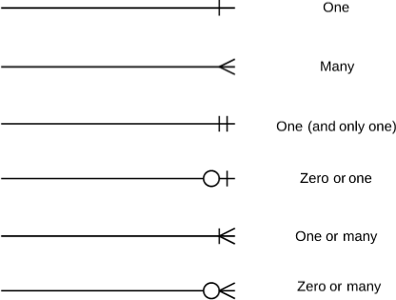
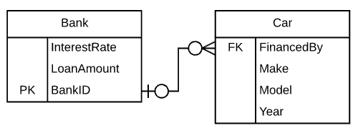

Crows Foot Notation

